Slide 1

NEW IDEA
ATM using face recognition

Slide 2
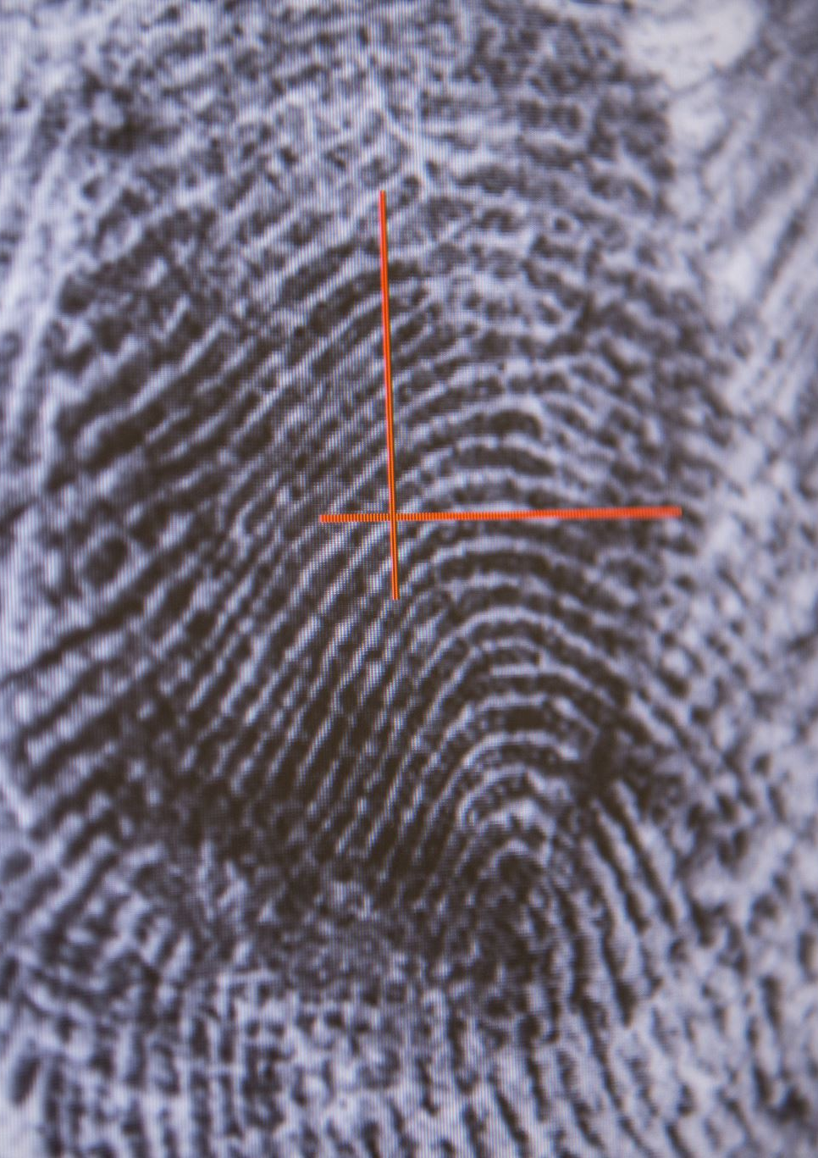
Existing
ATM contains the existing type as pin authentication, OTP authentication, fingerprint authentication,QR CODE

Slide 3
Our Idea
Make implementation of face recognition in ATM
If we forgot card or pin it is easy to mae our job easy
Mainly it is helpful for person with disability

Slide 4

Thank you

